Slide 1
DATA ACQUISITION AND ANALYSIS USING LabVIEW
MENTOR (Dr. MOHD. ZUHAIB)

Slide 2
Content
Introduction
Comparison Between Virtual And Traditional Instruments
Work Done
Conclusion

Slide 3
Introduction
Virtual Instrumentation combines mainstream commercial technologies such as the pc with flexible software and a wide variety of measurement and control hardware.
Combines powerful flexible software and pc technology to test,control,and design application making accurate analog and digital measurement.
Application ranges from simple laboratory experiments to large automation application.

Slide 4
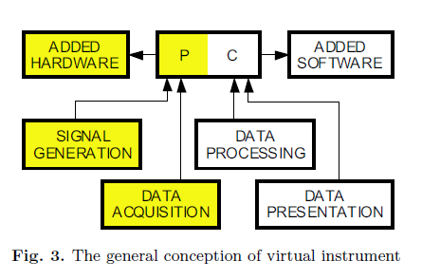
Virtual Instrumentation : Block Diagram

Slide 5
Virtual Instruments versus Traditional Instruments
Virtual instruments are defined by the user while traditional instruments have fixed, vendor-defined functionality.
Virtual instruments, by virtue of being PC-based, inherently take advantage of the benefits from the latest technology incorporated into off-the-shelf PCs.
Traditional instruments also frequently lack portability, whereas virtual instruments running on notebooks automatically incorporate their portable nature.

Slide 6
THD and its Components Measurement Using LabVIEW
Harmonics are the major distorting component in the mains voltage and load current waveforms.
This is due to rise in capacity of non-linear and critical loads, Power Quality (PQ) contamination is posing a threat on power systems, which may sometimes lead to malfunctioning and eventually failure of the equipments.
The system is developed on LabVIEW platform and the testing is done through generation of simulated distorted wave using LabVIEW.

Slide 7
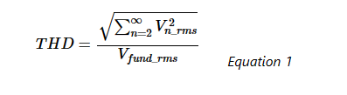
Total harmonic distortion
THD is defined as the ratio of the equivalent root mean square (RMS) voltage of all the harmonic frequencies (from the 2nd harmonic on) over the RMS voltage of the fundamental frequency.

Slide 8
Importance of THD Measurement
THD is important in several types of systems, including power systems, where a low THD means
higher power factor
lower peak currents
higher efficiency

Slide 9
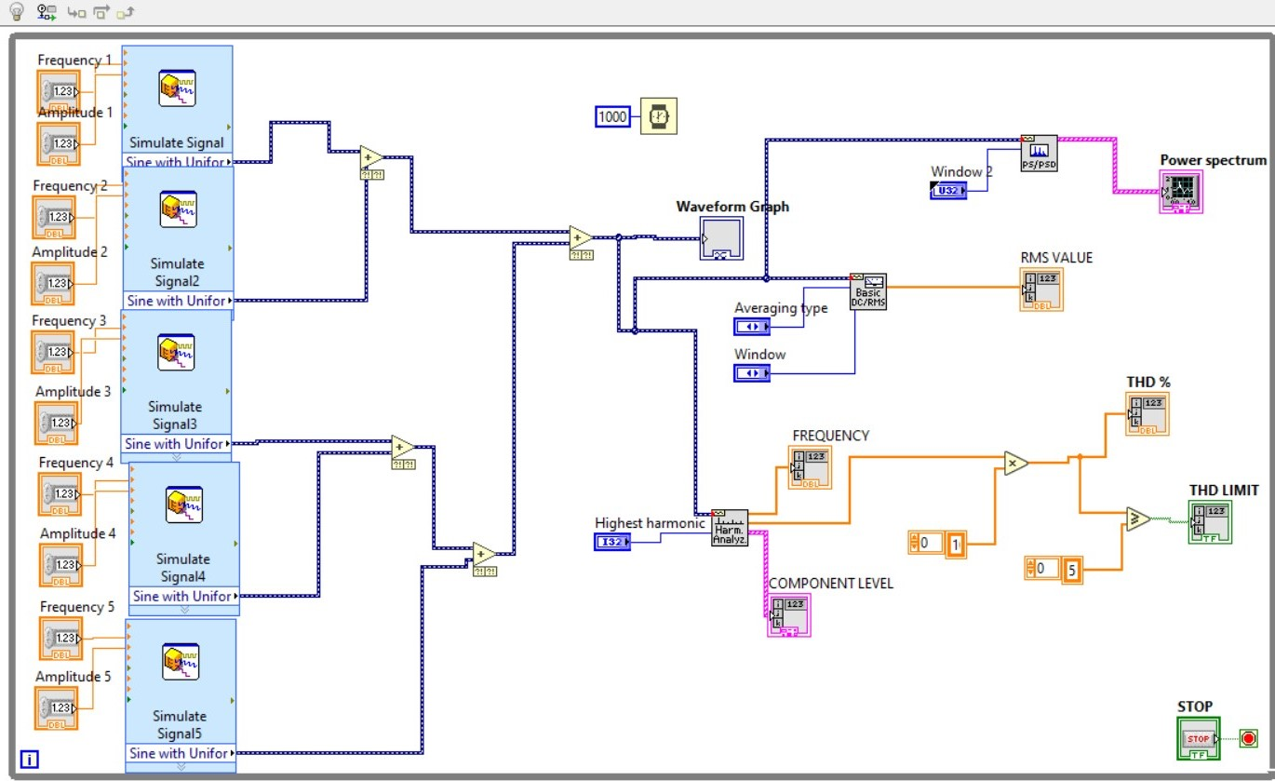
Block Diagram

Slide 10
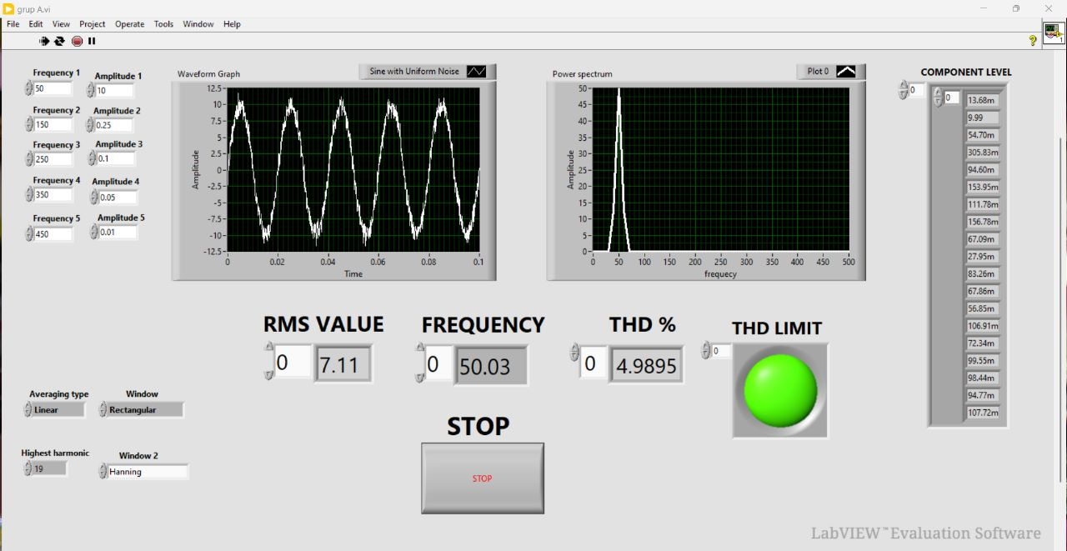
WHEN THD IS LESS THAN 5

Slide 11
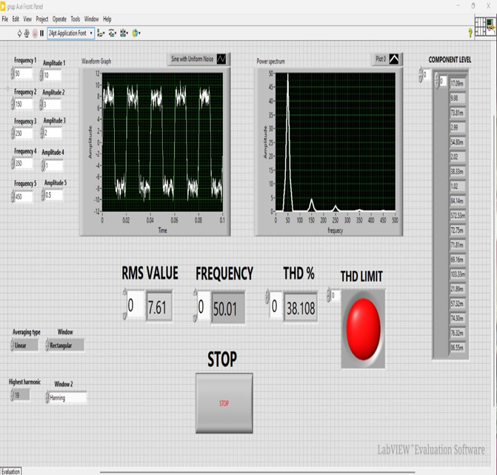
WHEN THD IS GREATER THAN 5

Slide 12
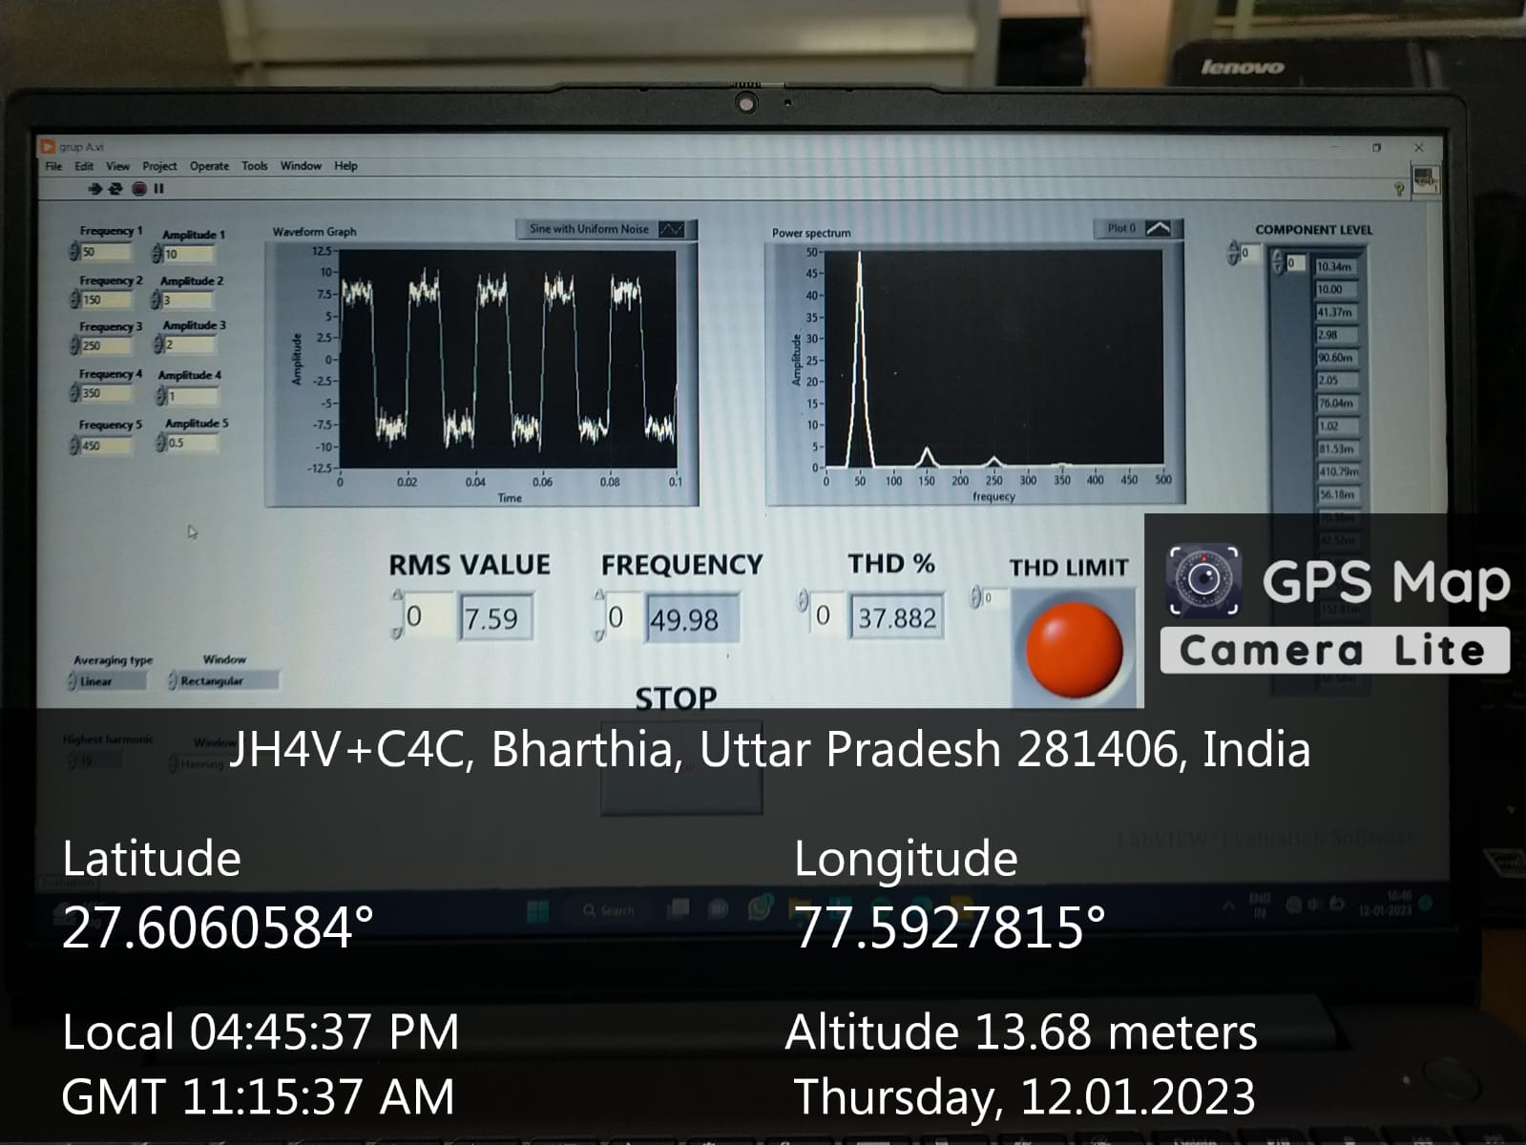
Geotagged Image

Slide 13
CONCLUSION
We measure THD, its components and power spectrum of a harmonic distorted signal using LabVIEW and make its graphical user interface.
When THD is lower than 5%, it is acceptable and there is low harmonic current and little risk of disturbance.
When THD is higher than 5% there is significant harmonic current and risk of heat rise and oversizing of supplies.

Slide 14
References
What is LabVIEW? Graphical Programming for Test & Measurement – NI
LabVIEW user manual 8.5.1.
M. Regula, A. Otcenasova, M. Roch, R. Bodnar and M. Repak, "Software for power quality monitoring in model smart grid with using LabView," 2016 ELEKTRO, Strbske Pleso, Slovakia, 2016, pp. 355-358, doi: 10.1109/ELEKTRO.2016.7512096.
Mishra, Debani & Ray, Papia. (2015). Calculation of power quality factor of supply system using LabVIEW. 10.1049/cp.2015.1622.
Jovitha Jerome, Virtual Instrumentation using LabVIEW, 2010 PHI, Learning Private Limited, New Delhi, ISBN-978-81-203-4030-5.
https://youtube.com/playlist?list=PL8oKCBEYiHMnUPowK0B7awUpej22UEc52.

